Slide 1
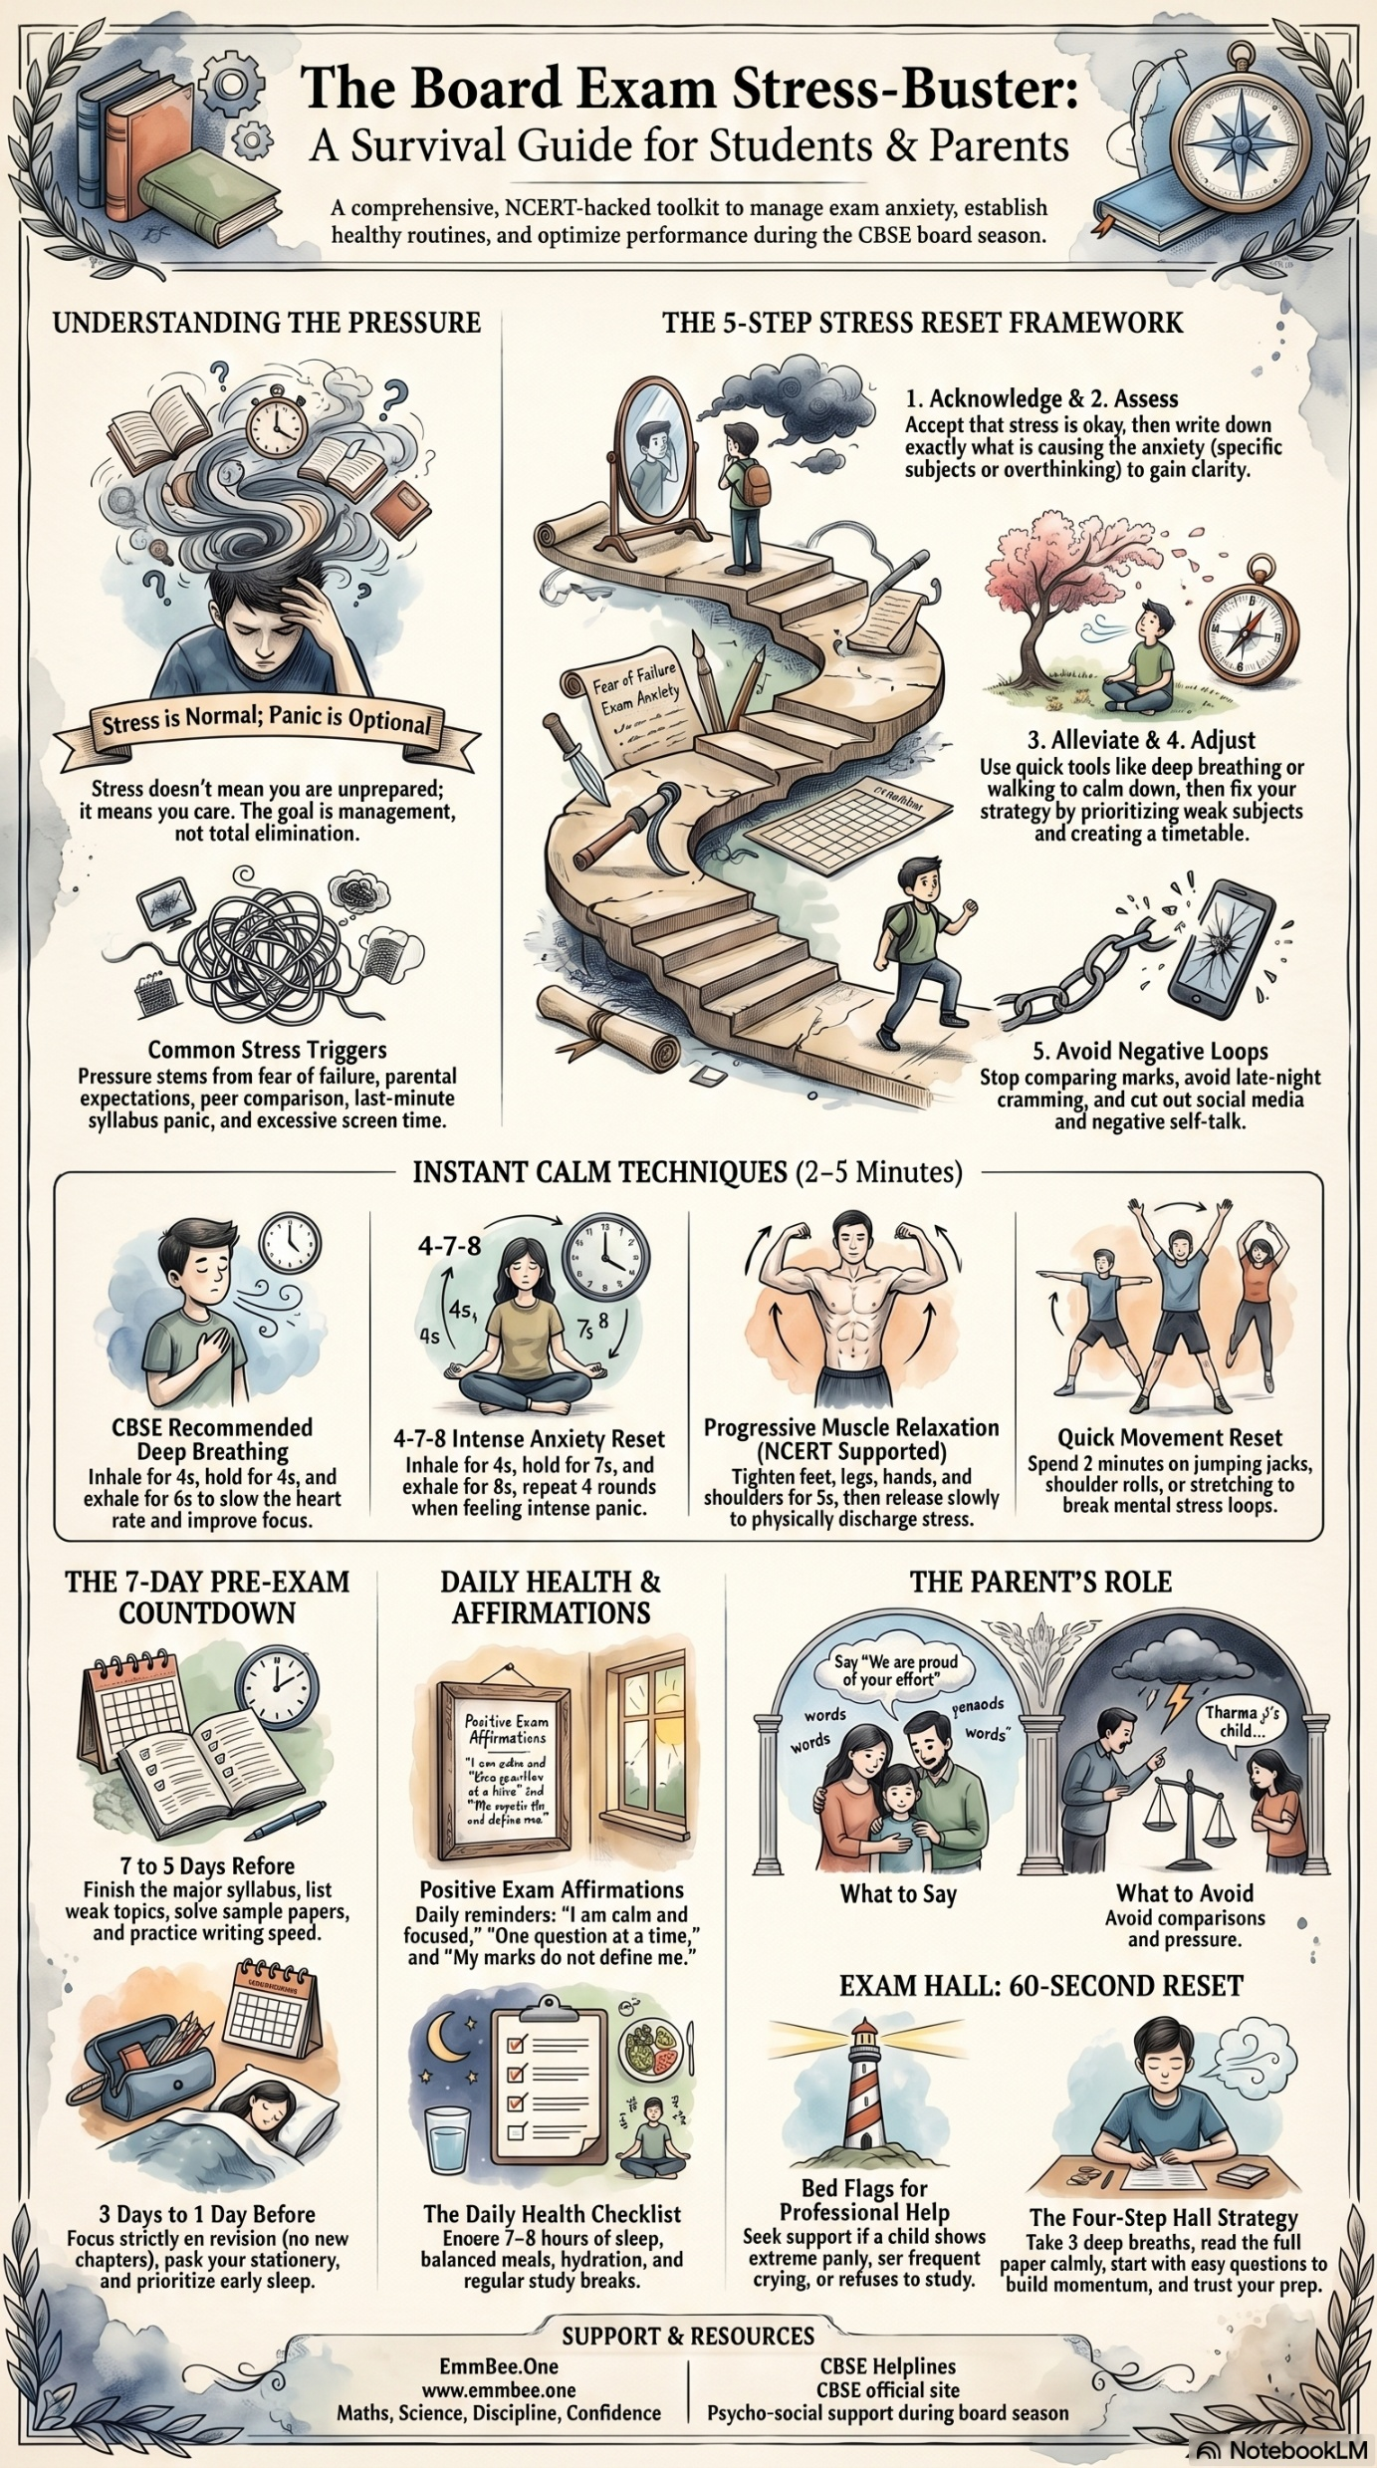

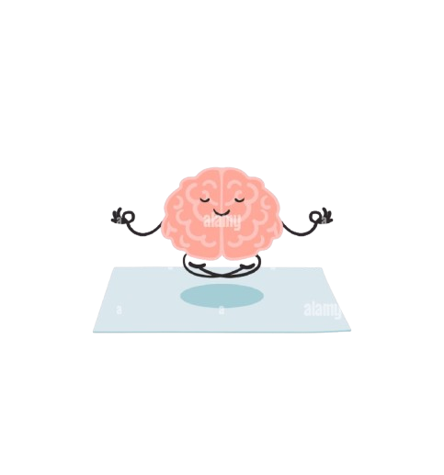
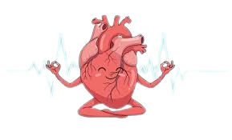


The Board Exam Stress-Buster
A Survival Guide For Students & Parents
A Comprehensive, CBSE & NCERT-Backed toolkit to manage exam anxiety, establish healthy routines, and optimize performance during the CBSE board season 2026.
UNDERSTANDING THE PRESSURE
THE 5-STEP STRESS RESET FRAMEWORK
1. ACKNOWLEDGE & 2. ACCESS
Accept that stress is okay, then write down
exactly what is causing the anxiety (specific subjects or overthinking) to gain clarity.
Stress is Normal; Panic is Optional
3. ALLEVIATE & 4. ADJUST
Stress doesn’t mean you are unprepared,
It means you care. The goal is Management,
Not total Eliminations.
Use quick tools like Deep-Breathing or Walking to calm down,
Then fix your strategy by prioritizing weak subjects and creating a timetable.
Common Stress Triggers
5. AVOID NEGATIVE LOOPS
Pressure stems from fear of failure, parental expectations, peer comparison, last-minute syllabus panic, and excessive screen time.
Stop comparing marks, avoid late night cramming, and cut
out social media and negative self- talk .
INSTANT CALM TECHNIQUES (2-5 MINUTES)
Inhale for 4s
Hold for 4s
Exhale for to 6s
Tighten feet, legs, hands, and shoulders for 5s, then release slowly
CBSE ROCOMMENDED DEEP BREATH TECHNIQUES
To slow the heart rate and improve focus.
PROGRESSIVE MUSCLE RELAXATION (NCERT SUPPORTED)
To physically discharge stress.
THE 7-DAY PRE-EXAM COUNTDOWN
DAILY HEALTH & AFFIRMATIONS
THE PARENT’S ROLE
Say, “We are proud of your efforts”.
Their child?
I need your understanding.
7 TO 5 DAYS BEFORE
Finish the full syllabus, sample papers, and practice writing speed.
POSITIVE EXAM AFFIEMATIONS
Daily reminds: “I am calm and focused”, “One question at a time” and “My marks do not define me.”
What to Say?
What to Avoid
Avoid Comparisons
and Pressure.
EXAM HALL: 60-SECOND RESET
3 days to 1 Day Before
The Daily Health Checklist
Red flags for professional help
The Four-Step Hall Strategy
Focus strictly on revision (no new chapters), pack your stationary and prioritize 8 hour sleep.
Ensure 7-8 hours of sleep, balanced meals, hydration and regular study breaks.
If child shows: Extreme panic, Frequent crying, Refusing to study,
Take 3 deep breaths, read full paper calmly, start with easy question and trust your prep.
SUPPORT & RESOURCES
EmmBee.One
www.emmbee.one | 7505705644
STRUCTURED ACADEMIC MENTORING
cbse.gov.in/examstress.htm
cbse.gov.in/examanxiety.htm
Made with care by emmbee.one

